Slide 1
An introduction to Shiny
Building Interactive R based Web apps using shiny

Slide 2
What is Shiny ?
Open Source web application framework for R, developed by Rstudio
Shiny makes it easy to turn analytical analysis into stylish, interactive web apps, presentable to a wider audience
Link to few examples of interactive web apps made using Shiny :
http://shiny.rstudio.com/gallery/
http://www.showmeshiny.com

Slide 3
What is needed to build the app using Shiny ?
Latest version of R installed in system,
“shiny” package installed,
Yes, you need not be an expert in HTML, CSS or JavaScript, little knowledge would work. However, Shiny makes it simple and easy.
We will use Rstudio for programming

Slide 4
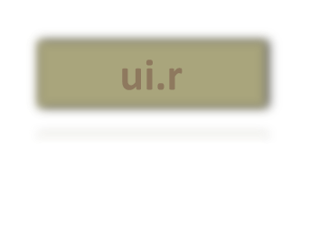
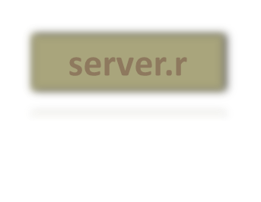
Getting started : ui.r and server.r
install.packages(“shiny”)
Create user interface in ui.R file,
Create the server.R file for computation purpose,
Create user interface :
Control the layout, appearance,
Widgets that capture user inputs.
Also, displays the output.
Eg, the title, page layout, text input, radio buttons, drop down menus, graphs etc.
Set of instructions that uses the input provided by the user , process them and produces the required output which is further displayed by ui.r script.

Slide 5
Structure of ui.r
library(shiny) # Remember to load the shiny package
# Define UI for the shiny application here.
shinyUI(fluidPage(
# Application title
titlePanel(),
# sidebarLayout(
# Sidebar panel
sidebarPanel(),
# Main Panel
mainPanel()
)
)
)

Slide 6
Structure of server.r
library(shiny)
shinyServer(
function(input, output) {
}
)

Slide 7

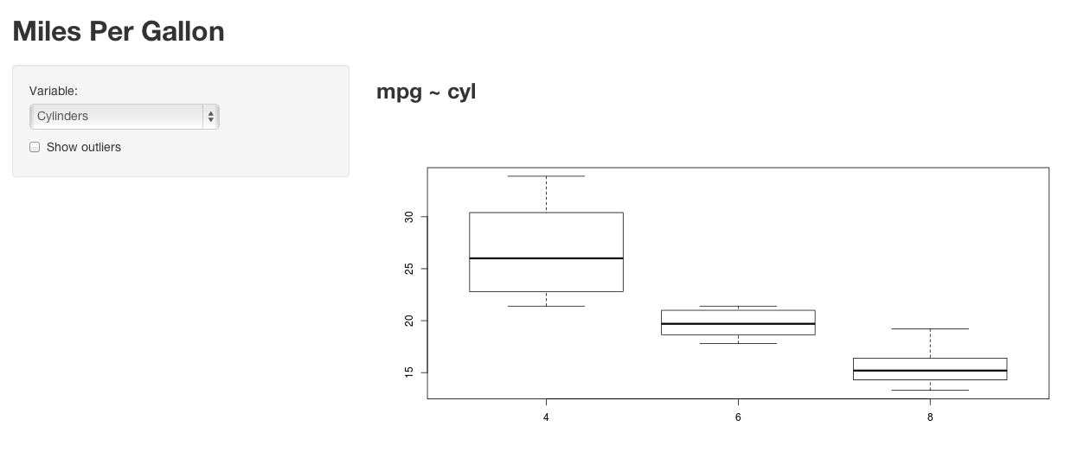


Components of the shiny ui.r page layout
Image source : http://shiny.rstudio.com/gallery/example-04-mpg.html

Slide 8
Running the shiny app
Save both the files ui.r and server.r in R working directory or any other folder,
Run the app in the local system using runApp() command specifying the folder name or use the runApp icon from Rstudio. There is option to run the app in the browser as well.
Share the app over the web (using github, dropbox, gist or shinyApps.io)

Slide 9
My First Shiny App – Hello Shiny!
Create a very simple shiny app – no computations but just display some text in the title panel, sidebar panel and main panel
Create the ui.R and server.R files
Save the files in the working directory &
Finally, run the app.

Slide 10
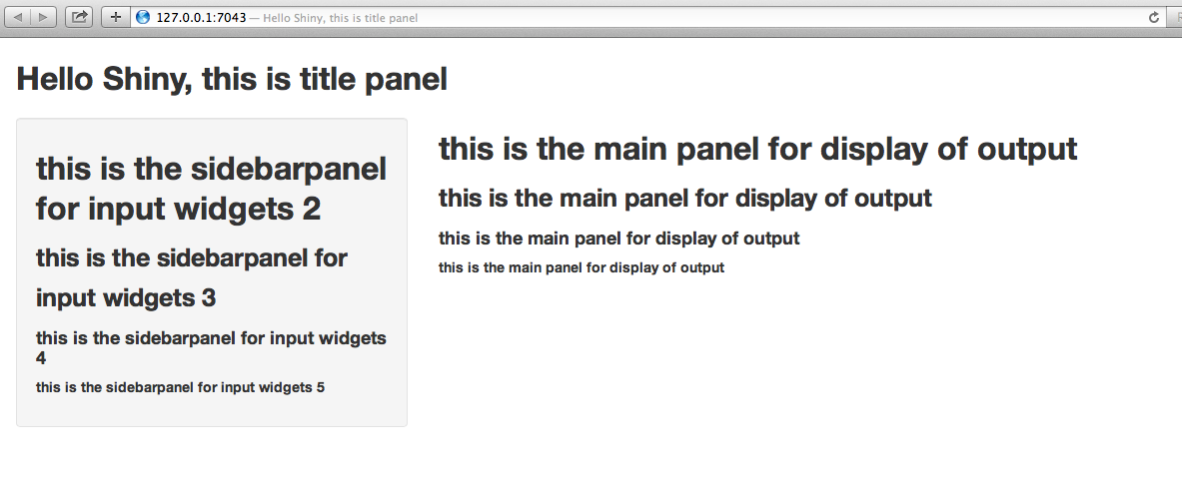
My First Shiny App – Hello Shiny!

